Slide 1

Data visualization BlinkIT Grocery Data
Pham Tieu Quyen Nguyen

Slide 2

oVERVIEW
Purpose: Analyzed BlinkIT’s grocery sales to uncover insights on item performance, outlet types, and customer trends through an interactive dashboard—enabling data-driven decisions.
Tools: Microsoft Excel
Techniques Used:
Pivot Tables
Charts and Graphs (Bar Chart, Donut Chart, Line Chart)
Slicers and Filters for interactivity

Slide 3
Implementation steps
Data Cleaning
KPI Calculation & Chart Preparation
Dashboard Design

Slide 4
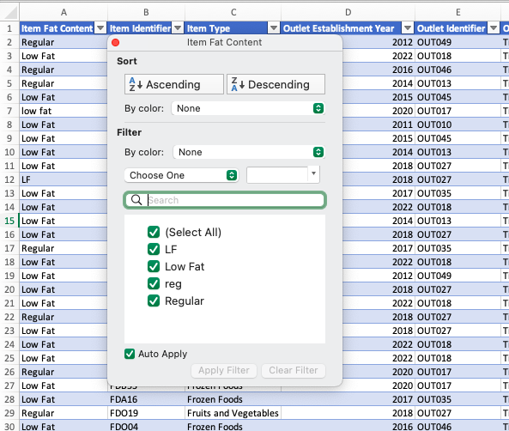
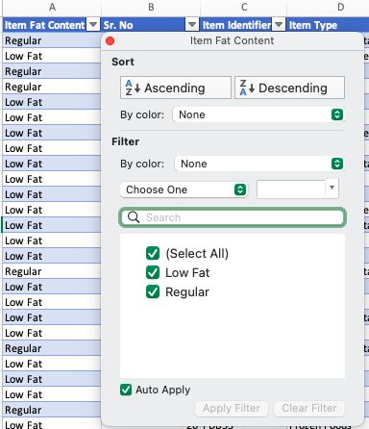
Data cleaning
Standardized the fat content data: “LF” → “Low Fat”, “reg” → “Regular”
Method Used: Find & Replace

Slide 5
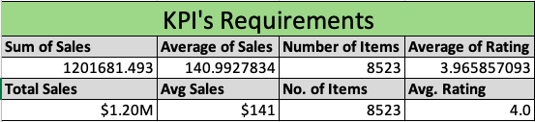
KPI calculation & Chart Preparation
Used Pivot Tables to calculate key metrics:

Slide 6
KPI calculation & Chart Preparation
Created charts for each analysis requirement:
Requirement | Objective | Chart Type
1. Total Sales by Fat Content | Analyze the impact of fat content on total sales. | Donut Chart
2. Total Sales by Item Type | Identify performance of different item categories. | Bar Chart
3. Fat Content by Outlet for Total Sales | Compare total sales across outlets by fat content. | Stacked Column Chart
4. Total Sales by Outlet Establishment | Understand how outlet age/type affects sales. | Line Chart
5. Sales by Outlet Size | Explore the relationship between outlet size and sales. | Donut / Pie Chart
6. Sales by Outlet Location | Assess geographic distribution of sales. | Funnel Map
7. All Metrics by Outlet Type | Provide a comprehensive view of all KPIs by outlet type. | Matrix Card

Slide 7
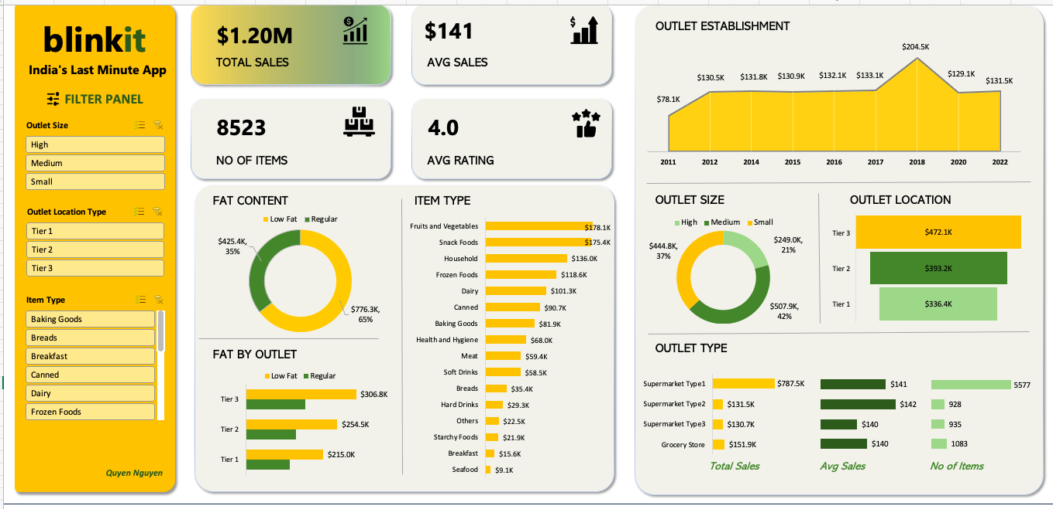
Dashboard design
Combined all visuals
Included slicers for:
Outlet Size
Outlet Location Type
Item Type

Slide 8
Outcome
The final dashboard offers clear, actionable insights into BlinkIT's operations. It enables stakeholders to:
- Understand customer preferences
- Track sales performance by category and outlet
- Make informed decisions regarding product stocking and outlet expansion

Slide 9
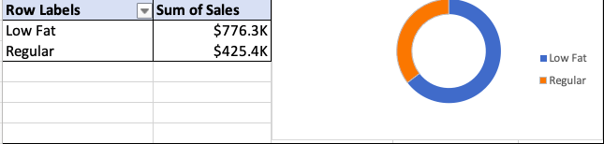
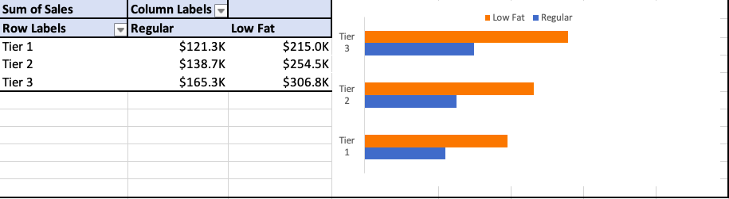
Appendix
Total Sales by Fat Content
Fat Content by Outlet for Total Sales

Slide 10
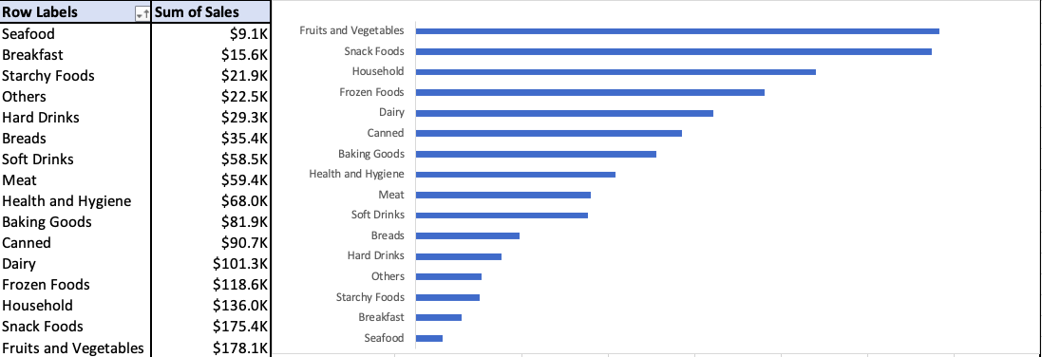
Appendix
Total Sales by Item Types

Slide 11
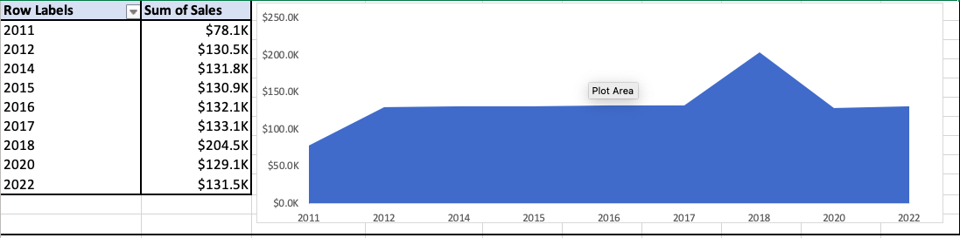
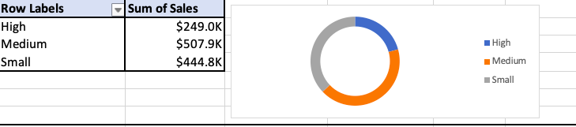
Appendix
Total Sales by Outlet Establishment
Sales by Outlet Size

Slide 12
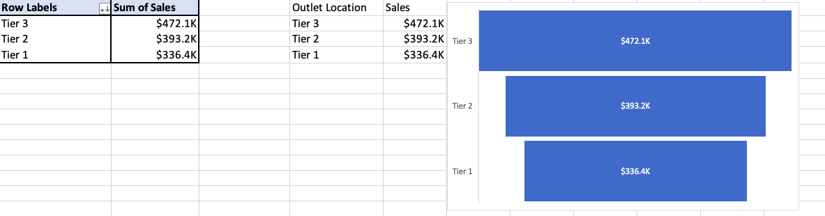
Appendix
Sales by Outlet Location

Slide 13
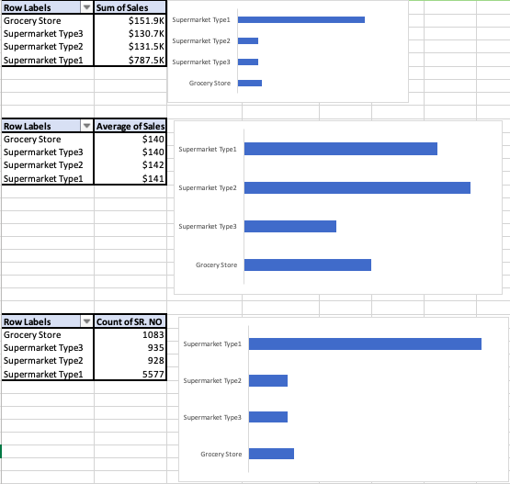
Appendix
All Metrics by Outlet Type

